Slide 1
5
INVERSE FUNCTIONS

Slide 2
5.8
Indeterminate Forms and L’Hospital’s Rule

Slide 3

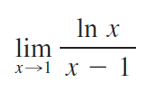

Indeterminate Forms and L’Hospital’s Rule
Suppose we are trying to analyze the behavior of the function
Although F is not defined when x = 1, we need to know how F behaves near 1. In particular, we would like to know the value of the limit

Slide 4

Indeterminate Forms and L’Hospital’s Rule
In computing the limit we can’t apply Law 5 of limits (the limit of a quotient is the quotient of the limits) because the limit of the denominator is 0.
In fact, although the limit in exists, its value is not obvious because both numerator and denominator approach 0 and is not defined.

Slide 5
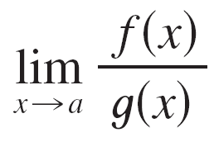
Indeterminate Forms and L’Hospital’s Rule
In general, if we have a limit of the form
where both f (x) → 0 and g(x) → 0 as x → a, then this limit may or may not exist and is called an indeterminate form of type .

Slide 6
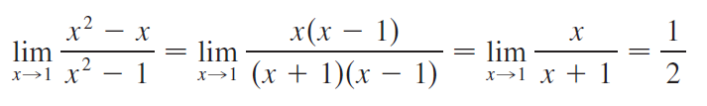


Indeterminate Forms and L’Hospital’s Rule
We met some limits of this type earlier. For rational functions, we can cancel common factors:
We used a geometric argument to show that
But these methods do not work for limits such as , so we introduce a systematic method know as l’Hospital’s Rule for the evaluation of indeterminate forms.

Slide 7


Indeterminate Forms and L’Hospital’s Rule
Another situation in which a limit is not obvious occurs when we look for a horizontal asymptote of F and need to evaluate the limit
It isn’t obvious how to evaluate the limit because both numerator and denominator become large as x → ∞.

Slide 8
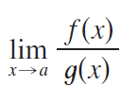
Indeterminate Forms and L’Hospital’s Rule
In general, if we have a limit of the form
where both f (x) → ∞ (or - ∞) and g (x) → ∞ (or - ∞), then the limit may or may not exist and is called an indeterminate form of type ∞/ ∞.
We saw that this type of limit can be evaluated for certain functions, including rational functions, by dividing numerator and denominator by the highest power of x that occurs in the denominator.

Slide 9
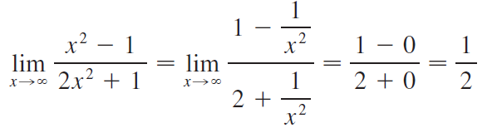

Indeterminate Forms and L’Hospital’s Rule
For instance,
This method does not work for limits such as , but l’Hospital’s Rule also applies to the type of indeterminate form.

Slide 10
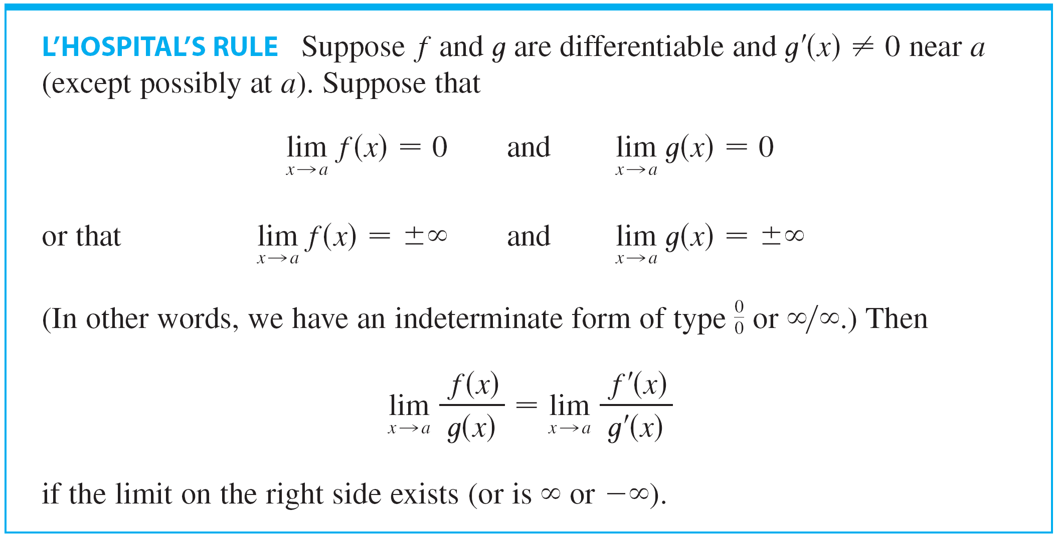
Indeterminate Forms and L’Hospital’s Rule

Slide 11
Indeterminate Forms and L’Hospital’s Rule
NOTE 1 L’Hospital’s Rule says that the limit of a quotient of functions is equal to the limit of the quotient of their derivatives, provided that the given conditions are satisfied.
It is especially important to verify the conditions regarding the limits of f and g before using l’Hospital’s Rule.
NOTE 2 L’Hospital’s Rule is also valid for one-sided limits and for limits at infinity or negative infinity; that is, “x → a” can be replaced by any of the symbols x → a⁺, x → a–, x →∞ , or x → -∞ .

Slide 12
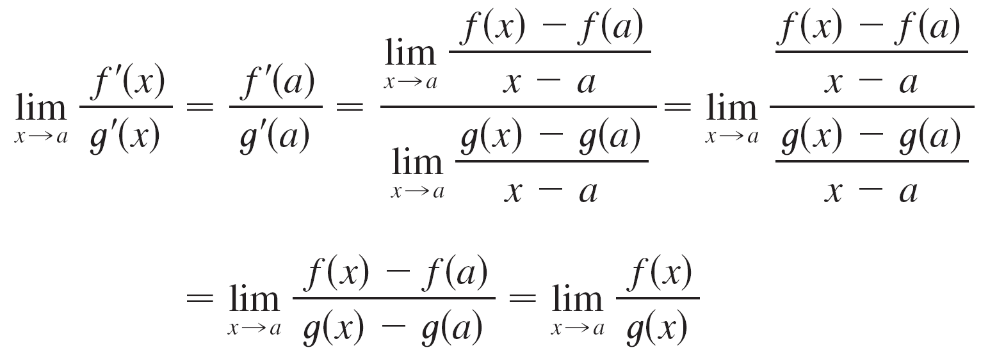
Indeterminate Forms and L’Hospital’s Rule
NOTE 3 For the special case in which f (a) = g(a) = 0, f ′ and g′ are continuous, and g′(a) ≠ 0, it is easy to see why l’Hospital’s Rule is true.
In fact, using the alternative form of the definition of a derivative, we have

Slide 13
Example 1
Find
SOLUTION
Thus, we can apply l’Hospital’s Rule:

Slide 14
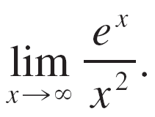
Example 2
Calculate

Slide 15
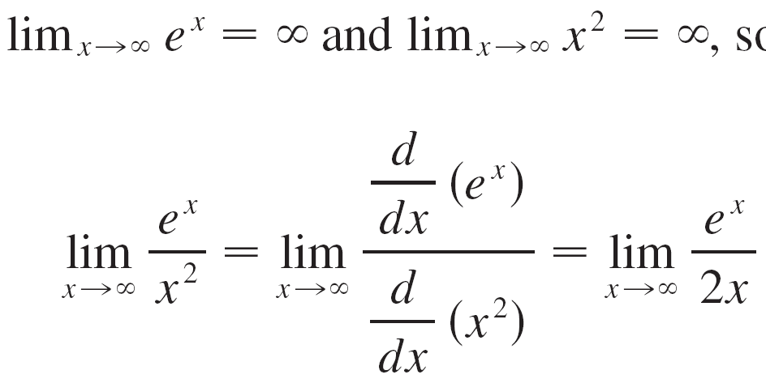
Example 2 – Solution
SOLUTION:
We have and so l’Hospital’s Rule gives

Slide 16

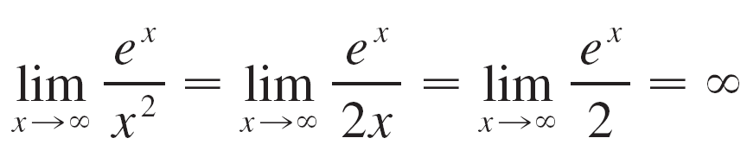
Example 2 – Solution
cont’d
Since e^{x} → and 2x → as x → , the limit on the right side is also indeterminate, but a second application of l’Hospital’s Rule gives

Slide 17
Example 3
Calculate
SOLUTION
As ln x → ∞ and as x → ∞, l’Hospital’s Rule applies:
Notice that the limit on the right side is now indeterminate of type .

Slide 18
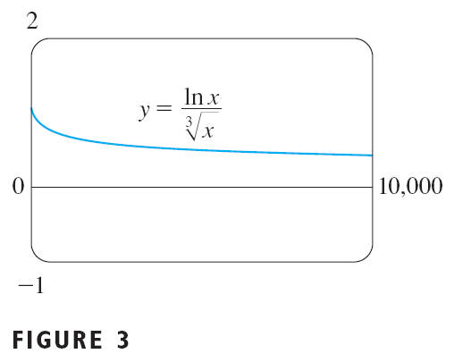
Example 3 SOLUTION
However, instead of applying the rule a second time as we did in Example 2, we simplify the expression and see that a second application is unnecessary:

Slide 19
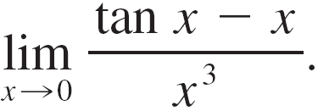
Example 4
Find

Slide 20
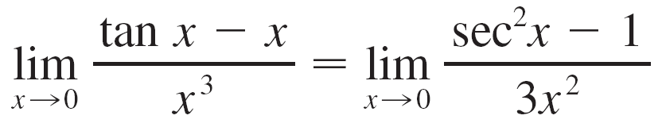

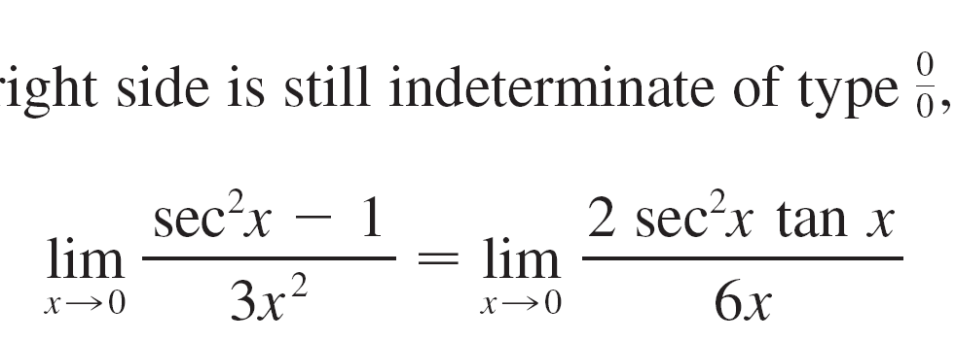
Example 4 – Solution
SOLUTION:
Noting that both tan x – x → 0 and x³ → 0 as x → 0, we use l’Hospital’s Rule:
Since the limit on the right side is still indeterminate of type we apply l’Hospital’s Rule again:

Slide 21

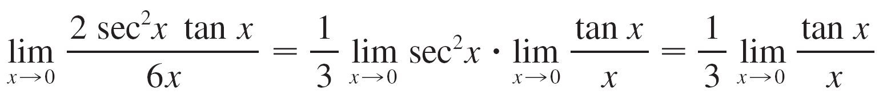
Example 4 – Solution
cont’d
Because we simplify the calculation by writing

Slide 22
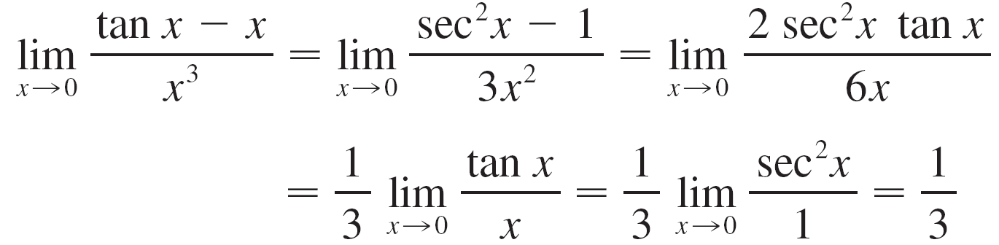
Example 4 – Solution
cont’d
We can evaluate this last limit either by using l’Hospital’s Rule a third time or by writing tan x as (sin x)/(cos x) and making use of our knowledge of trigonometric limits. Putting together all the steps, we get

Slide 23
Example 4 – Solution
cont’d

Slide 24
Example 5
Find
SOLUTION
If we blindly attempted to use l-Hospital’s rule, we would get:

Slide 25
Example 5 SOLUTION
This is wrong.
Although the numerator sin x → 0 as x → π –, notice that the denominator (1 – cos x) does not approach 0.
So, the rule can’t be applied here.
The required limit is, in fact, easy to find because the function is continuous at π and the denominator is nonzero there:

Slide 26
L’HOSPITAL’S RULE
Example 5 shows what can go wrong if you use the rule without thinking.
Other limits can be found using the rule, but are more easily found by other methods.
See Examples 3 and 5 in Section 2.3, Example 3 in Section 4.4, and the discussion at the beginning of this section.
So, when evaluating any limit, you should consider other methods before using l’Hospital’s Rule.

Slide 27
Indeterminate Products

Slide 28



Indeterminate Products
If and then it isn’t clear what the value of if any, will be.
There is a struggle between f and g. If f wins, the answer will be 0; if g wins, the answer will be .
Or there may be a compromise where the answer is a finite nonzero number.
This kind of limit is called an indeterminate form of type 0  .

Slide 29
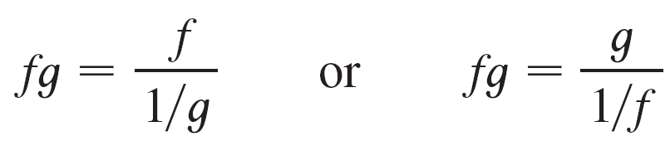

Indeterminate Products
We can deal with it by writing the product fg as a quotient:
This converts the given limit into an indeterminate form of type or so that we can use l’Hospital’s Rule.

Slide 30
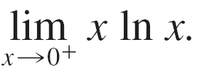
Example 6
Evaluate

Slide 31
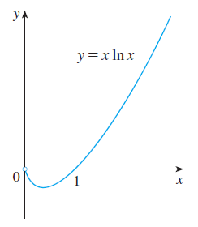
Example 6
Figure 5 shows the graph of the function in Example 6.
Notice that the function is undefined at x= 0; the graph approaches the origin but never quite reaches it.
Figure 5

Slide 32
Example 6 – Solution
SOLUTION:
The given limit is indeterminate because, as x → 0⁺, the first factor (x) approaches 0 while the second factor (In x) approaches . Writing x = 1/(1/x), we have 1/x → as x → 0⁺, so l’Hospital’s Rule gives

Slide 33
Note
In solving the example, another possible option would have been to write:
This gives an indeterminate form of the type 0/0.
However, if we apply l’Hospital’s Rule, we get a more complicated expression than the one we started with.
In general, when we rewrite an indeterminate product, we try to choose the option that leads to the simpler limit.

Slide 34
Indeterminate Differences

Slide 35
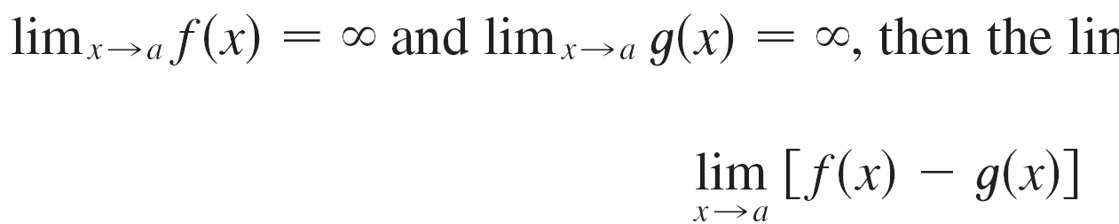
Indeterminate Differences
If and , then the limit
is called an indeterminate form of type – .
Again there is a contest between f and g. Will the answer be
(f wins) or will it be - (g wins) or will they compromise a finite number? To find out, we try to convert the difference into a quotient so that we have an indeterminate form of type or

Slide 36
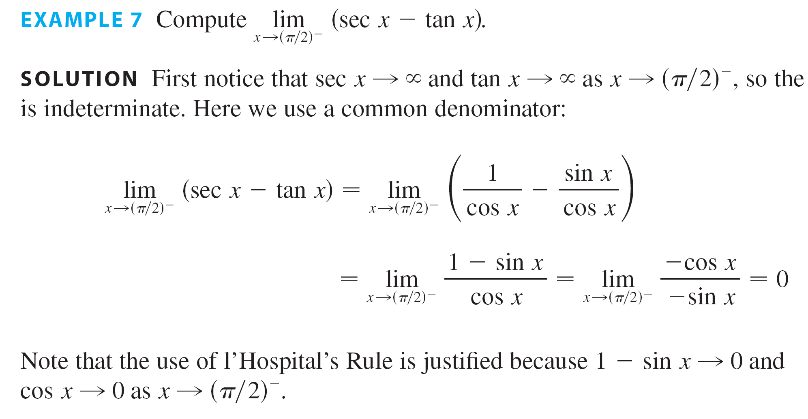
Example 7
Compute

Slide 37
Example 7 – Solution
SOLUTION:
First notice that sec x → and tan x → as x → (π /2)–, so the limit is indeterminate. Here we use a common denominator:

Slide 38
Example 7 – Solution
cont’d
Note that the use of l’Hospital’s Rule is justified because 1 – sin x → 0 and cos x → 0 as x → (π /2)–.

Slide 39
Indeterminate Powers

Slide 40
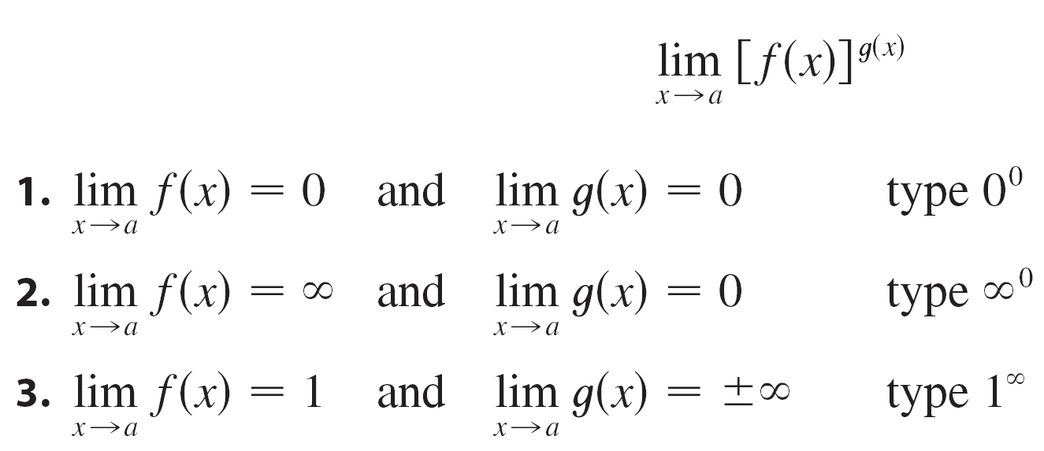
Indeterminate Powers
Several indeterminate forms arise from the limit

Slide 41
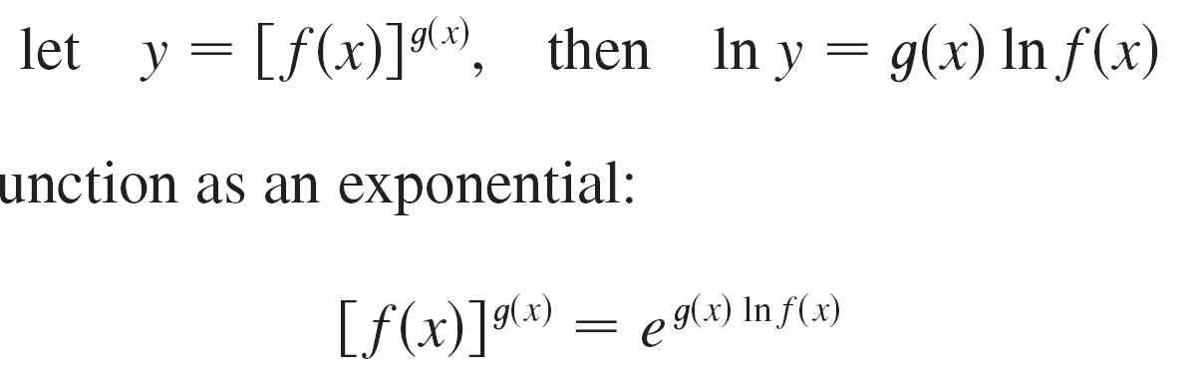
Indeterminate Powers
Each of these three cases can be treated either by taking the natural logarithm:
or by writing the function as an exponential:
In either method we are led to the indeterminate product g(x) lnf (x), which is of type 0  .

Slide 42

Example 8
Calculate

Slide 43

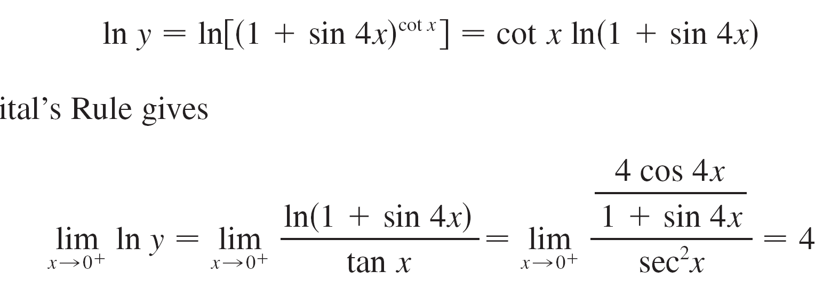
Example 8 – Solution
SOLUTION:
First notice that as x → 0⁺, we have 1 + sin 4x → 1 and cot x → , so the given limit is indeterminate.
Let
Then

Slide 44
Example 8 – Solution
cont’d
l’Hospital’s Rule gives

Slide 45
Example 8 – Solution
cont’d
So far we have computed the limit of In y, but what we want is the limit of y.
To find this we use the fact that y = e ^{In y} :

Slide 46
Example 9
Find
SOLUTION
Notice that this limit is indeterminate since 0^{x} = 0 for any x > 0 but x⁰ = 1 for any x ≠ 0.

Slide 47
Example 9 – Solution
We could proceed as in Example 8 or by writing the function as an exponential: x^{x} = (e^{ln x})^{x} = e^{x ln x}
In Example 6, we used l’Hospital’s Rule to show that
Therefore,

